Slide 1
Needfinding
(Learning Studio)
Tyler Berbert, Matthew Chen, Jiawen Guo

Slide 2
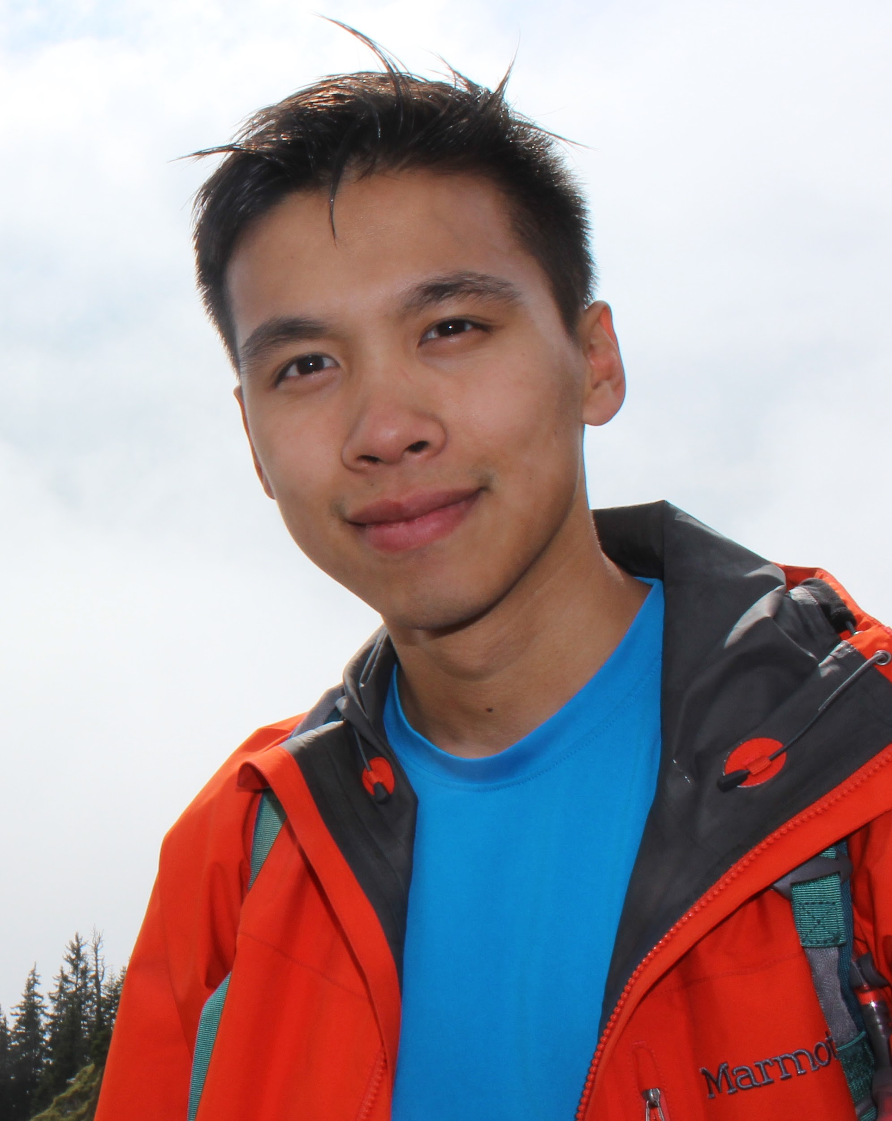


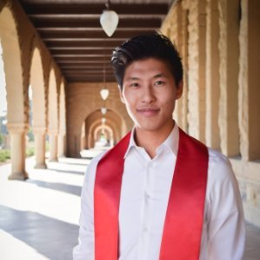
Meet the Team
Matthew Chen
MSCS ‘17
Hometown : New York
Jiawen Guo (Kat)
MA CEAS ‘17
Hometown : Xiamen, China
Tyler Berbert
BS SymSys ’17
Hometown : Walnut Creek, CA
Andrew Han

Slide 3
Needfinding Methodology

Slide 4
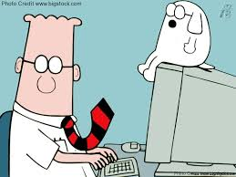
Target Group
Post-college Professionals (Learning Needs)
Hypothesis : There is an unmet need for continual learning in fast changing fields
Jimmy, Lawyer
Debbie, Doctor
Roger, Software Engineer
Joel, Designer
Aileen, Teacher
Notes:
Include some statistics about these profession

Slide 5
Key Questions
How quickly is your field moving? How do you keep up?
How does the pace of change in your field make you feel?
What would like to know that you do not know now? Why not learn it?

Slide 6
Interview Results

Slide 7
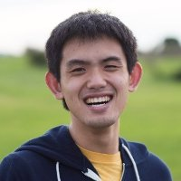
Roger - Front-end Engineer
“Don't want my ability to go into a new field that I might be interested in to be limited by my lack of fundamental skills in those area.”
“having classmates = mutual in person learning experience, don't feel as bad about asking dumb fundamental questions. self-studying = self justifying understanding, leaning more heavily on piazza”

Slide 8
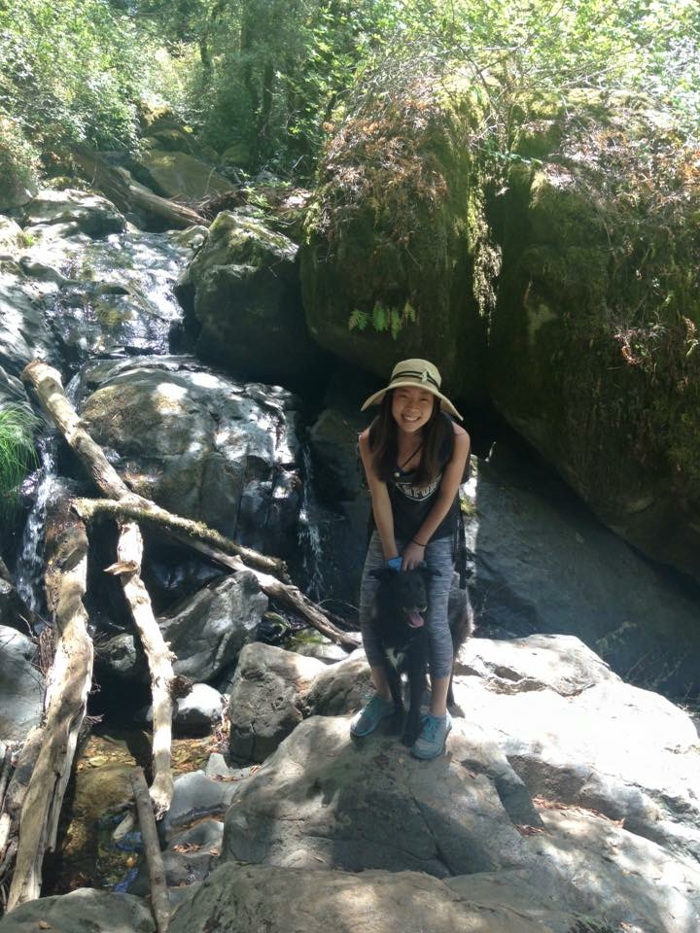
Aileen - Elementary School Teacher
“A major obstacle to teaching -- In class, kids often get distracted by things happening in their lives and cannot focus on learning.”
“ The field is changing every year with new teaching standards, methods. Old teachers find it harder to keep up.”

Slide 9
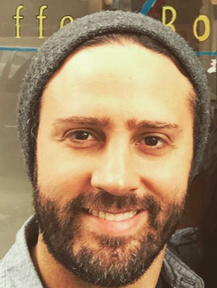
Joel - Designer
“You don’t want to follow the puck, you want to be where the puck is going to be”
“It’s good to know a formal or abstract way of doing things, but it might not work in reality for your company”

Slide 10
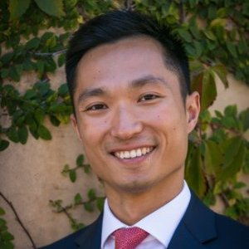
Jimmy - Lawyer
“The field has changed significantly in the past 10 years”
“Most lawyers lack the business knowledge to give strategic legal advice”
“I don’t use the new legal resources because learning trade off relative to the marginal benefit”

Slide 11
Analysis

Slide 12
Inferences
Learning individually and in groups are both important; creates a feedback loop; you hear about new things, implement them yourself, show off your results, etc.
Professionals have well established pipelines for getting new information in their field of work
Learning does not slow down after college

Slide 13
Questions
What is the best combination of individual and group learning?
How can brand-new industry trends and practices best be taught to a wider audience?
Where is the right entry point to learn about a new unfamiliar field?
Can this be built into an online or mobile platform?

Slide 14
Empathy Map
Think
Already inundated with information
Don’t want to be too specialized
Want to be up to date and relevant in current times
Web development is still trying to figure out appropriate philosophies
Learning individually and in groups are both important
Say
“Rate of learning has not decreased, it has increased actually”
“Learn better with classmates”
“There are two or three resource that I use to keep up to date”
“Style of learning since leaving school involves hands-on work rather than abstract or theory-based study”
Do
Keep up to date with new material through forums, papers, conferences, etc.
Ad-hoc learning for new web frameworks
Study new industry trends and tools by looking at new products and what the younger generation is doing
Feel
Exhausted by work
Frustrated with patients
Frustrated with kids
Fear of being pigeonholed
Lost in uncertainty
Fear of losing jobs
Powerless
Anxious about keeping up

Slide 15
Needs and Insights
Knowing what to learn is difficult. How do I learn only the useful things?
Get information from others without signaling a lack of information
Notes:
Anonymous forum or chat bot (reddit model for companies)
You get notifications when questions you are following get answered
Chat bot to ping appropriate users

Slide 16
It would be game changing if we could…
Create a platform for people to learn professional skills in a social environment
Create an easier way to help people understand how the latest developments apply to their job
Create a safe environment to ask questions

